Slide 1



K.J Somaiya Institute of technology
Department of Artificial Intelligence and Data Science
Academic Year 2022-23
AI-Resume Analyser
SHUBHAM AGARWAL

Slide 2
Outline of Presentation
Introduction
Summary / Finding of Literature Survey
System Design & Architecture
Proposed Methodology( Algorithm / Flowchart etc)
Video & Audio demonstration of Running Project(5Mins)
Results
Conclusion
References

Slide 3
Introduction
The job market is highly competitive, and job seekers need to create resumes that stand out from the crowd.
However, many job seekers struggle to create resumes that effectively showcase their skills and experience. On the other hand, employers receive a large number of resumes for each job opening, and it can be difficult to screen all the resumes effectively.[2]
To bridge this gap, we propose an AI-based resume analyzer, which can help both job seekers and employers. The AI Resume Analyser is designed to analyze resumes and provide job seekers with feedback on how they can improve their resumes, and employers with the best candidates for their job openings.[1]

Slide 4
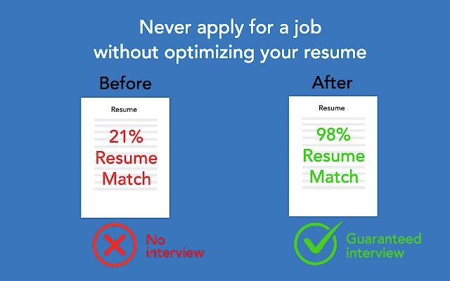
Summary / Finding of Literature Survey
Our literature survey revealed that current resume screening methods often result in biases towards gender, race, and other characteristics, leading to a reduction in the diversity of the candidates. AI-based resume analyzers can help eliminate such biases and promote diversity.

Slide 5
System Design & Architecture
The AI Resume Analyser uses NLP to analyze resumes. The system architecture comprises three stages: pre-processing, feature extraction, and classification.
The pre-processing stage involves extracting the text from the resume, removing stop words, and converting the text to numerical form.
The feature extraction stage involves selecting the most relevant features from the resume, which are used for classification.
The classification stage involves using a machine learning algorithm to predict the job seeker's suitability for the job.

Slide 6
Proposed Methodology( Algorithm / Flowchart etc)
The proposed methodology for the AI Resume Analyser involves the following steps:
Step 1: Pre-process the resume text by removing stop words, punctuation marks, and special characters.[1]
Step 2: Extract features from the pre-processed text using NLP techniques. This involves identifying and selecting the most relevant features from the resume, such as skills, work experience, education, etc.[2]
Step 3: Use the NLP algorithm to classify the resume based on the extracted features. The NLP algorithm is trained on a unlabelled dataset of resumes to predict the suitability of a new resume.[1]

Slide 7
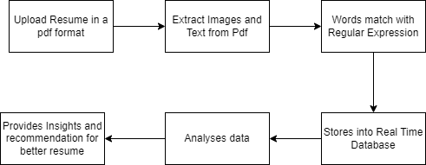
Flow Chart

Slide 8
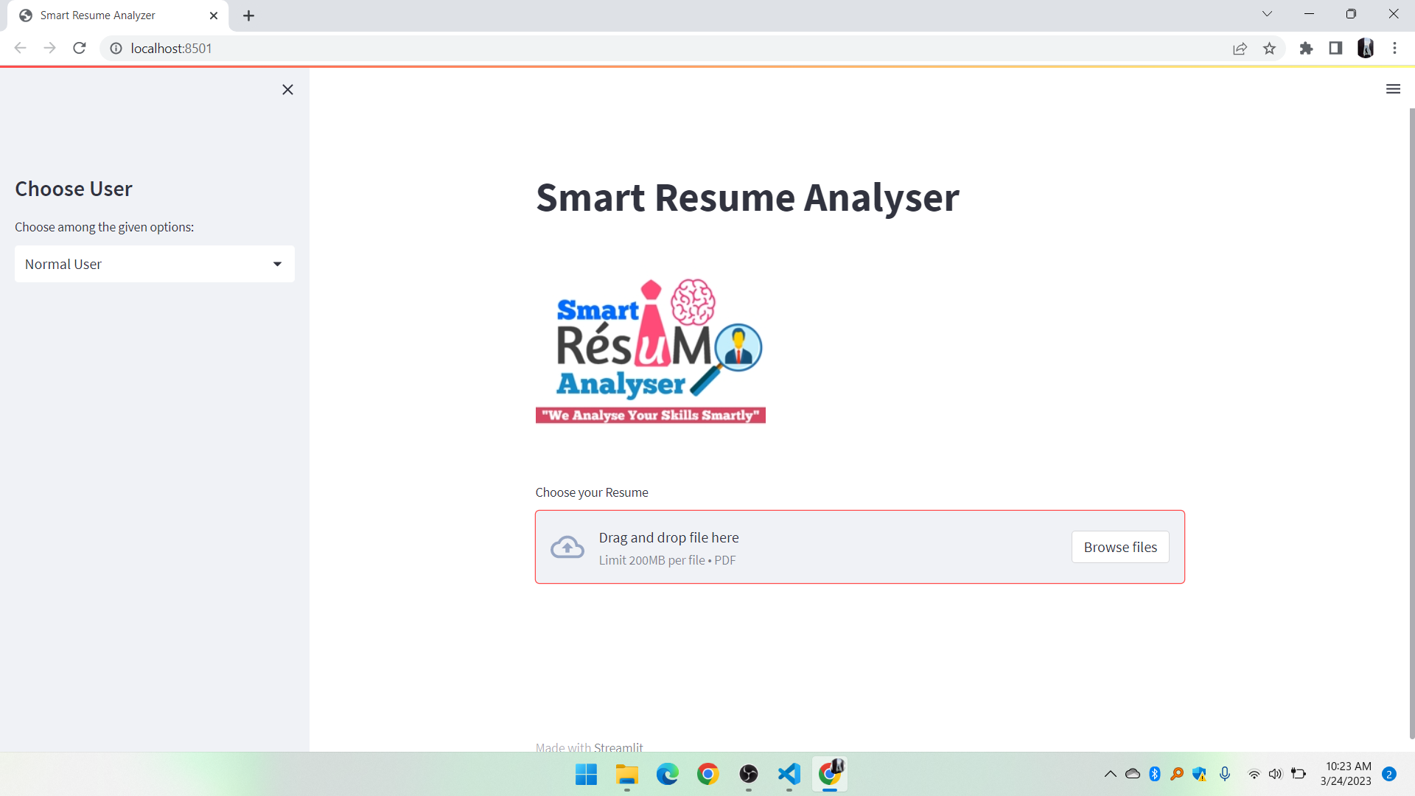
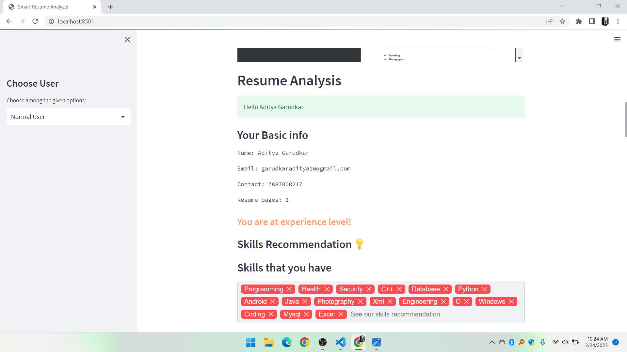
Results
KJSIT-IET INTECH 2K23 National Level Poster cum Project Competition

Slide 9
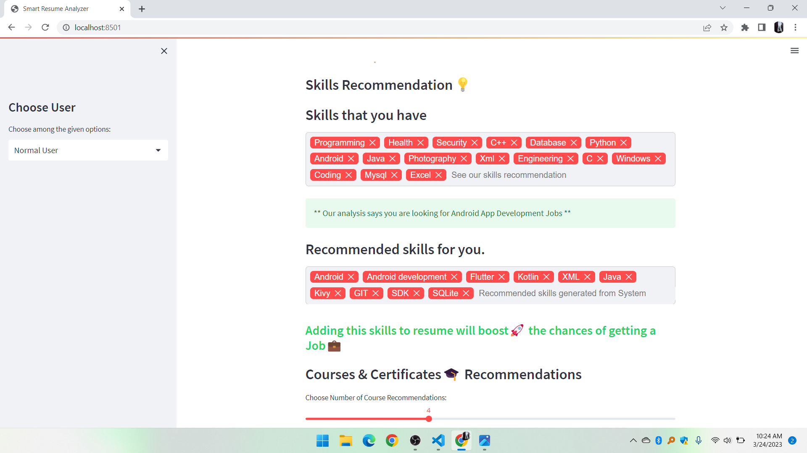
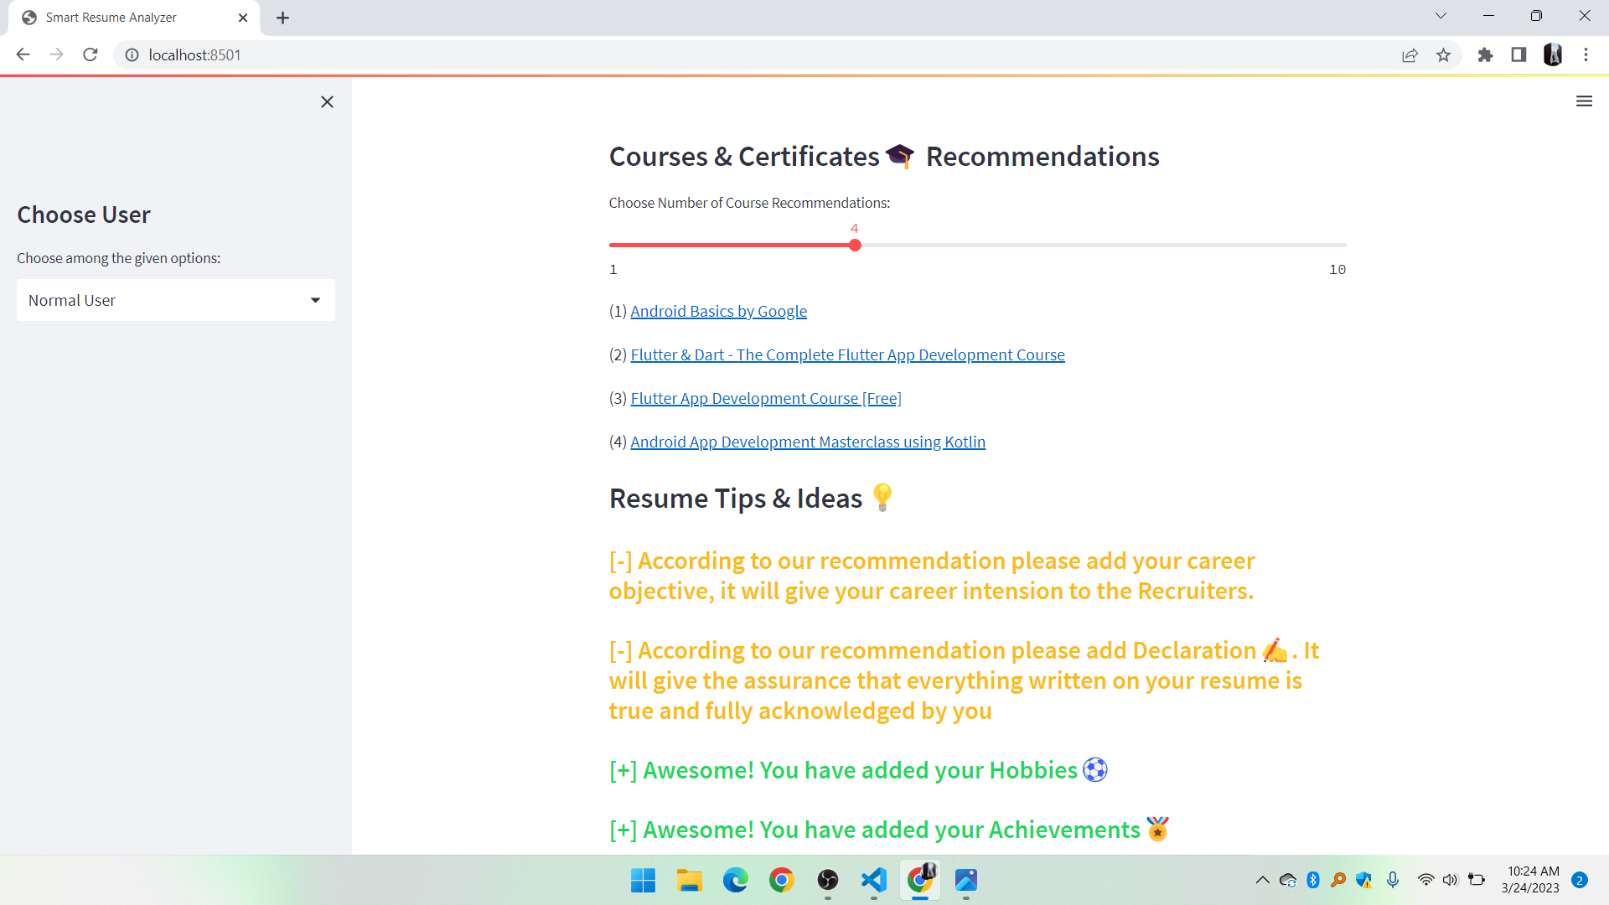
Results
JSIT-IET INTECH 2K23 National Level Poster cum Project Competition

Slide 10
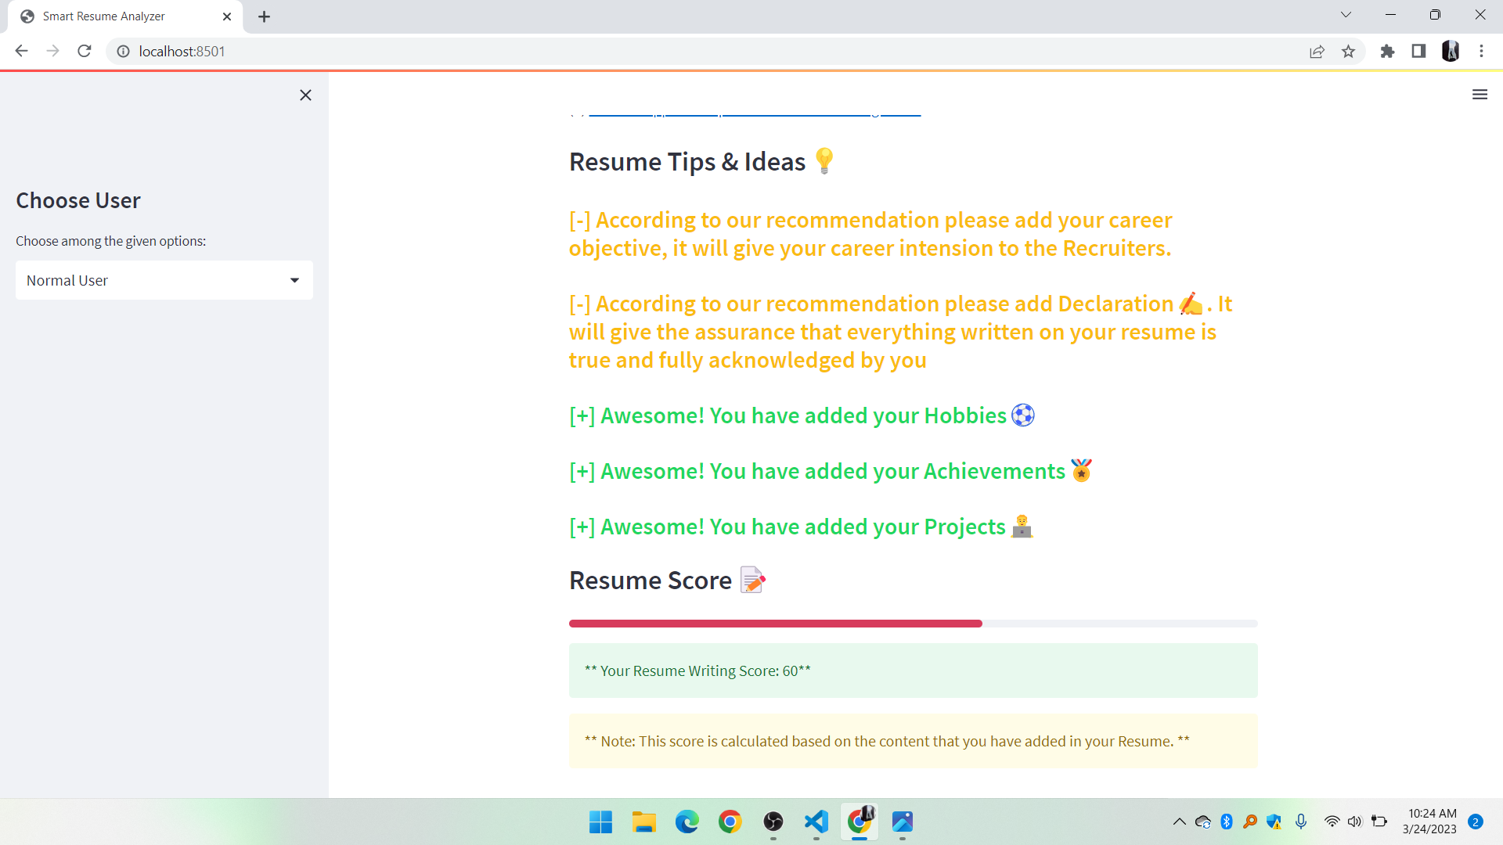
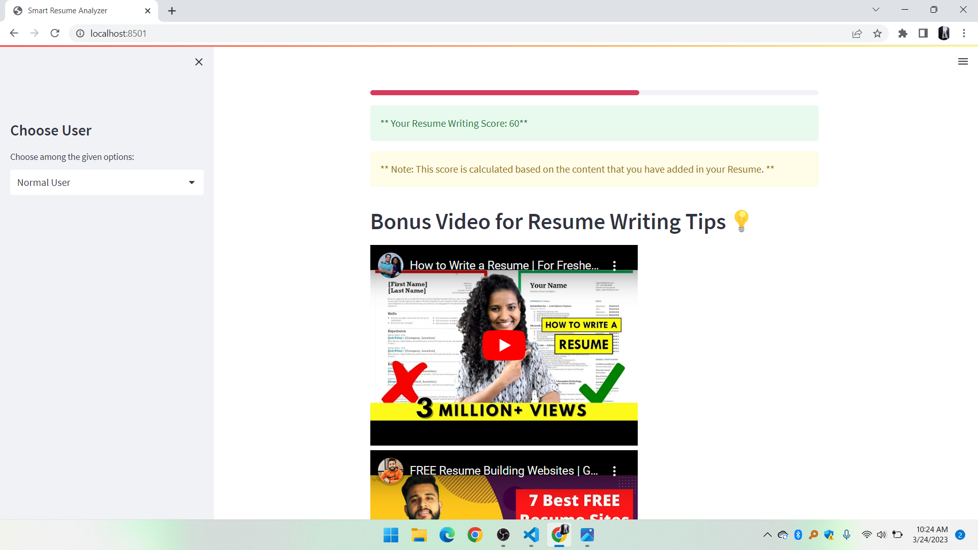
Results
KJSIT-IET INTECH 2K23 National Level Poster cum Project Competition

Slide 11
Conclusion
The AI Resume Analyser can help reduce the time and effort required for recruiters to screen resumes, improve the diversity of the candidate pool, and provide valuable feedback to job seekers to improve their resumes.[2]
We also found that the system was unbiased towards gender and race, promoting diversity in the candidate pool.

Slide 12
References
Zhang, J., Liu, Y., & Su, J. (2020). AI-Based Resume Screening and Analysis System. In 2020 IEEE 4th Conference on Energy Internet and Energy System Integration (EI2) (pp. 767-771). IEEE.
Aggarwal, A., & Jain, V. (2021). An efficient resume analyzer system using natural language processing. Journal of King Saud University-Computer and Information Sciences, 33(3), 383-390.

